Slide 1

Music Genre Classification
Submitted By:-
Daksh Semwal, Akaansh Danu ,Akash Negi ,Abhishek Juyal

Slide 2
Abstract
This project is primarily aimed to create an automated system for classification model for music genres. The first step included finding good features that demarcated genre boundaries clearly.
A total of five features, namely MFCC vector, Chroma frequencies, spectral roll off, spectral centroid, zero-crossing rate were used for obtaining feature vectors for the classifiers from the GTZAN genre dataset.
Key words: music, genre, classification, MFCC, Chroma, ensemble classifiers, spectral features, GTZAN genre dataset

Slide 3
Introduction
Wikipedia states that “music genre is a conventional category that identifies pieces of music as belonging to a shared tradition or set of conventions.”
The term “genre” is a subject to interpretation and it is often the case that genres may very fuzzy in their definition.
Further, genres do not always have sound music theoretic foundations, e.g. - Indian genres are geographically defined, Baroque is classical music genre based on time period.
Despite the lack of a standard criteria for defining genres, the classification of music based on genres is one of the broadest and most widely used.
Genre usually assumes high weight in music recommender systems. Genre classification, till now, had been done manually by appending it to metadata of audio files or including it in album info.

Slide 4
Related Work
The most influential work on genre classification using machine learning techniques was pioneered by Tzanetakis and Cook .
The GTZAN dataset was created by them and is to date considered as a standard for genre classification.
Scaringella et al. gives a comprehensive survey of both features and classification techniques used in the genre classification.
Changsheng Xu et al. have shown how to use support vector machines for this task.
Most of the work deals with supervised learning approaches. Riedmiller et al. use unsupervised learning creating a dictionary of features. gives a detailed account of evaluation of previous work on genre classification.

Slide 5



Requirement
Minimum 16GB of RAM
CUDA enabled graphic card for parallel processing (NVIDIA GEFORCE 920 M) with minimum 2/4 GB graphic memory.
A Quad Core CPU like intel i5 for smooth running but a core i3 will also work
Python , MATLAB

Slide 6
Datasets

Slide 7
GTAZAN
It contains 9 music genres; each genre has 100 audio clips in .au format.
The genres are - blues, classical, country, disco, pop, jazz, reggae, rock, metal.
Each audio clips have a length 30 seconds, are 22050Hz Mono 16-bit files. The dataset incorporates samples from variety of sources like CDs, radios, microphone recordings etc.
We split the dataset in 0.9: 0.1 ratio and used 5-fold cross validation for reporting the results.

Slide 8
Requirement
Minimum 16GB of RAM
CUDA enabled graphic card for parallel processing (NVIDIA GEFORCE 920 M) with minimum 2/4 GB graphic memory.
A Quad Core CPU like intel i5 for smooth running but a core i3 will also work

Slide 9
Python Libraries Used
Django (1.11)
Numpy (1.12.1)
Scikit-Learn (0.18.1)
Scipy (0.19.0)
Python-Speech-Features (0.5)
Pydub (0.18.0)

Slide 10
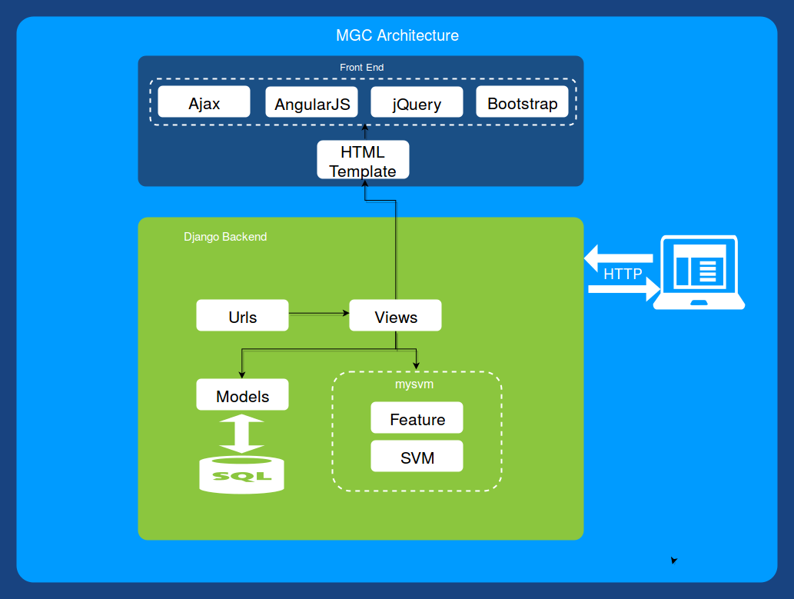
Application Architecture

Slide 11
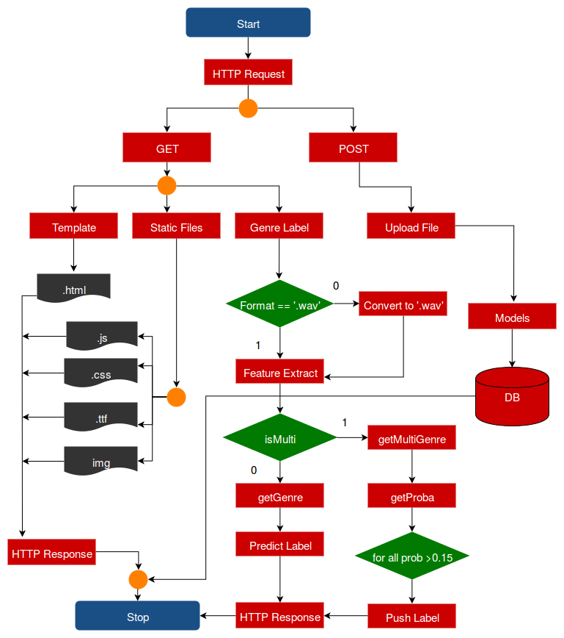
Working

Slide 12
Classification
K-Nearest Neighbours (KNN)
Principle is that the data instance of the same class should be closer in the feature space.
For a given data point x of unknown class, we can compute the distance between x and all the data points in the training data and assign the class determined by k nearest points of x.
Suppose we are given training datasets of n points
{(x1,y1),(x2,y2)……(xn,yn)}
where (xi ,yi) represents data pair i.
xi - feature vector
yi – target class
For a new data point x the most likely class is determined by finding the distance from all training data points (Euclidian distance). The output class will be the class which k nearest neighbors belongs to. K is a predefined integer (k=1, k=2, k=3.)

Slide 13
Classification (Contd.)
Logistic Regression
It is one of the widely used classification algorithm.
This algorithm is used in medical as well as business fields for analytics and classification.
This model has a hypothesis function 0 ≤ h (x) ≤ 1.Where hθ(x) = 11 + e-θTx called as Sigmoid or Logistic Function.
For Binary class classification y ∈{0, 1}.
The output of this classifier will be a probability of the given input belonging to class 1
If hθ(x) outputs 0.7 it means that the given input has 70% chance of belonging to class 1.
Since we have 10 genre classes y ∈{0, 1 .. 9} we used one-vs-all method for classification

Slide 14
Python package mysvm
For this project we developed a mysvm.
It contains three module
features
svm
acc
These are used by web application in feature extraction and finding genre.
This package also contains many other functions to do complicated feature extraction and classification.

Slide 15
Result
Classifier | Training Accuracy | Testing Accuracy
K-Nearest Neighbours |  | 53%
Logistic Regression | 75.778% | 54%
SVM Linear Kernel | 99% | 52%
SVM RBF Kernel | 99% | 12%
SVM Poly Kernel | 99% | 64%
** 6 genre classes we are getting an accuracy of 85%**

Slide 16
Conclusion
We found from our research that we can get maximum accuracy of 65% by using poly kernel SVM for 10 genre.
If we choose 6 genre classes we were able to get an accuracy of 85%.
For the web application we used these labels
Classical
Hip-hop
Jazz
Metal
Pop
Rock

Slide 17

Thank You

